Slide 1


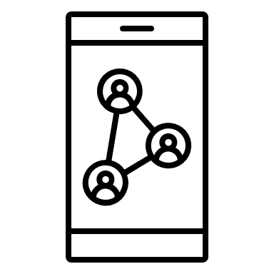





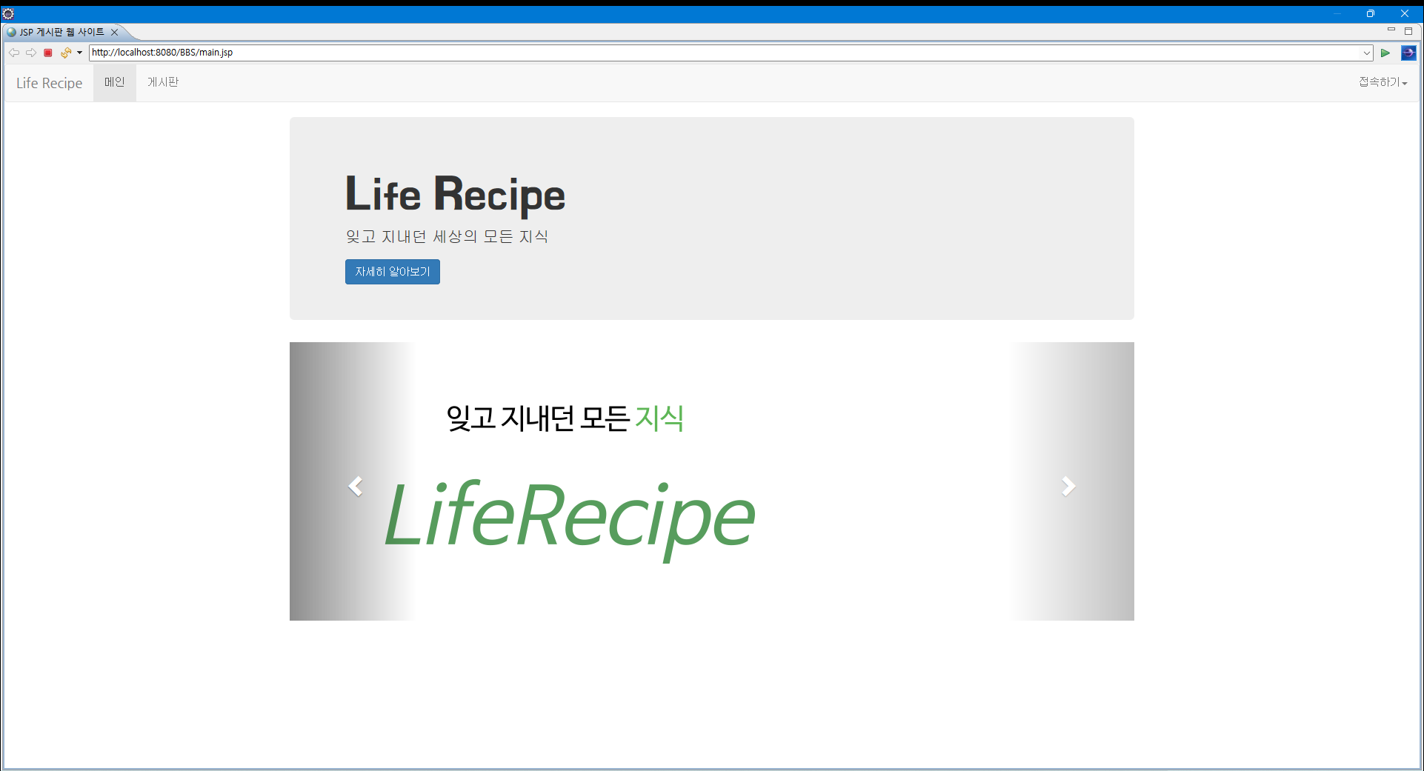
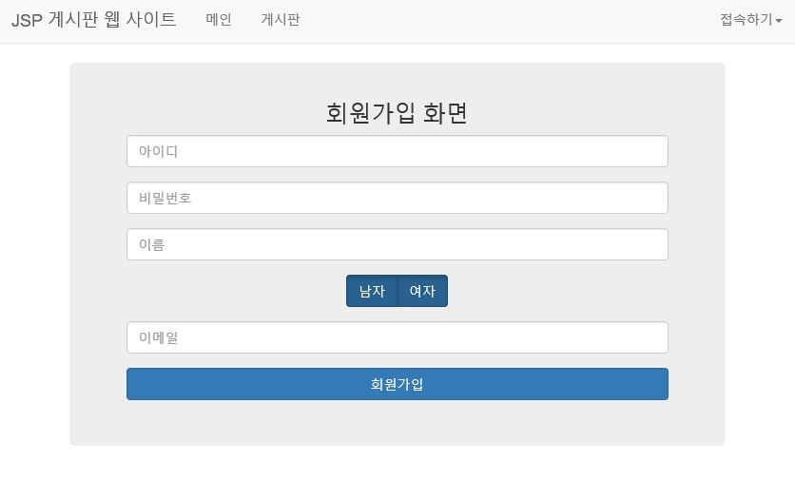
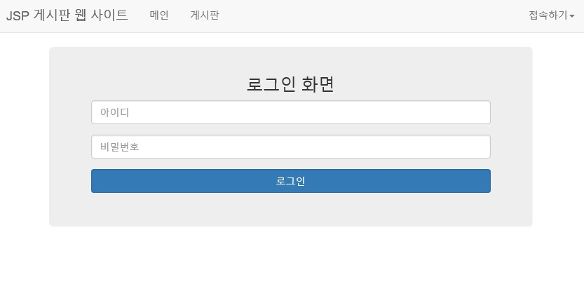
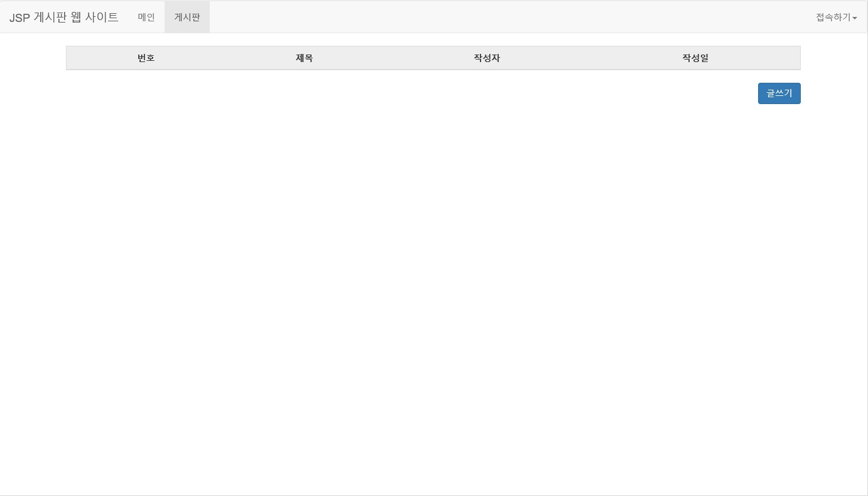




CEDC
December 17-19, 2021 Online event
Creative Engineering Design Competition
Life-Recipe ~ Daily knowledge collection website~
Kim sihoon¹ , Jeong Chaerin² , Kim Kyungwook³
Software major of CBNU, Team Green-Apple
Background & Purpose
Concept & Idea
Background
While looking for items for development, we started development when one of our team members said, "I wish there was a site where we could see common sense in life.
Purpose
Our goal is to quickly and easily inform common sense of life that is easy to forget in everyday life and to make it simple to register.
Example) Wedding clothes, order, etc.
Our idea is a wiki-type "living knowledge collection site" that anyone can participate in. After all, we want to create a site tailored to the user's convenience.
Representative functions of the website consist of membership registration, login, main page, and notice board. The notice board is a function that can only be used by logging in.
Design & Functions
1. Main page 2. Membership screen 3. Login screen 4. notice board
4. When writing, the date and ID are entered into the database. And it is possible for only the author to modify and delete the text.
Future works
1. The first goal is to implement additional functions of web pages.
-> Added category function and search function.
2. Recommendation, non-recommendation, and discussion functions will also be added.

